Slide 1
European Geography
Review

Slide 2
Land Features of Europe
British Isles
Iberian Peninsula
Atlas Mountains
North Africa
Great European Plains
Pyrenees Mountains
The Alps (Mountains)

Slide 3
Bodies of Water in Europe
Mediterranean Sea
Black Sea
Atlantic Ocean
Bay of Biscay
Strait of Gibraltar

Slide 4
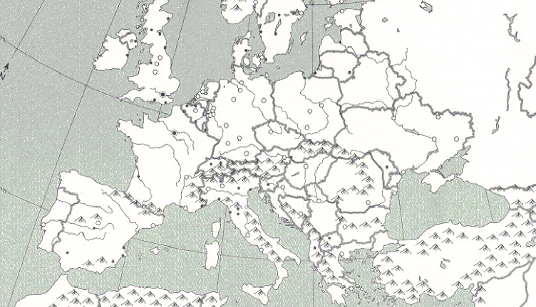
Which sea boarders North Africa and Southern Europe?

Slide 5
What feature connects the Atlantic Ocean to the Mediterranean Sea?

Slide 6
This Northern part of a continent is separated from Europe by the Mediterranean Sea and Atlas Mountains.

Slide 7
This body of water is Northeast of the Mediterranean Sea and in the Eastern part of Europe.

Slide 8
This land form is almost completely surrounded bodies of water, like the Bay of Biscay, Mediterranean Sea and Atlantic Ocean.

Slide 9
What body of water boarders the Iberian Peninsula and leads into the Atlantic Ocean?

Slide 10
Which mountain range separates the Iberian Peninsula from the rest of Europe?

Slide 11
Which mountain range separates Italy from the rest of Europe?

Slide 12
This land form spreads across the Northern part of Europe and is where most of Europe's farming takes place.

Slide 13
Which mountain range separates North Africa from the Mediterranean Sea?

Slide 14
This group of islands is North of the Bay of Biscay and Central Europe.

Slide 15
Which major ocean boarders the West Coast of British Isles and Western Europe?

